Slide 1
Power Electronics
ELL302
Semester I Academic Year 2022-23 Lecture 1
4th August 2022

Slide 2
Course Outline
Total number of lecture – 26
Total lecture hours – 39
Minor Exam – 26th September 2022
Number of assignments – 4
Major exam (as per schedule)
Minor exam – 30%
Assignments – 30%
Major Exam – 40%
Relative grading
Minimum 40% marks to be obtained for NP (Audit)

Slide 3
Course Contents
Power semiconductor devices – power diodes, thyristors, MOSFETs, IGBTs, majority and minority carrier devices, selection of devices, losses in devices, driving the devices, protecting the devices
AC-DC – uncontrolled rectifier and its design, design of output filter, controlled rectifier using thyristor, firing angle control, analysis of quality of output DC voltage, quality of current drawn from AC supply at different loads, applications
DC-DC – derivation of Buck, Boost and Buck Boost circuits, design of passive components and device selection, pulse width modulation (PWM) control, Flyback converter, applications
DC-AC – principle of conversion of DC-AC using different conduction modes, analysis of the harmonic content in output voltage, improving the harmonic content using sine PWM (SPWM), amplitude and frequency control, single phase and three phase, applications
AC-AC – cycloconverters
Application of control systems in power electronic converters

Slide 4
References
Power Electronics (3rd Edition) – Cyril W. Lander
Power Electronics – Converters, Applications and Design – Ned Mohan, Tore M. Undeland and William P. Robbins
Power electronics – Essentials and Applications – L. Umanand

Slide 5
Power Switch

Slide 6
Power Switch

Slide 7
Power Switch

Slide 8
Power Switch

Slide 9
Power Electronics
ELL302
Semester I Academic Year 2022-23 Lecture 2
7th August 2022

Slide 10
Power Switch

Slide 11
p-n Junction

Slide 12
p-n Junction

Slide 13
p-n Junction

Slide 14









p-n Junction

Slide 15
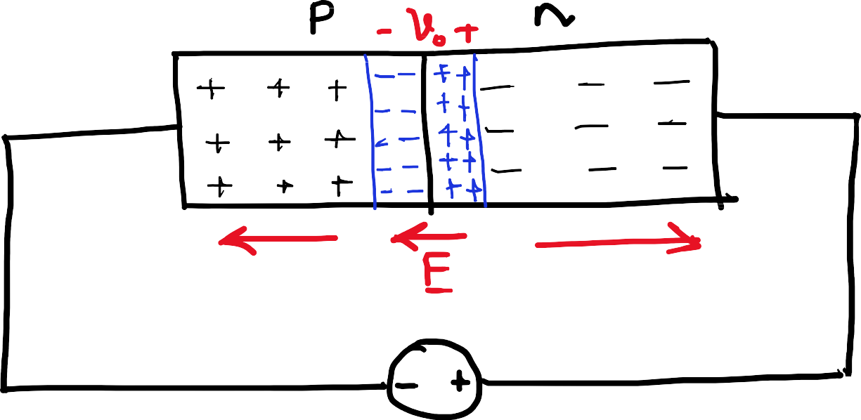
























p-n Junction

Slide 16
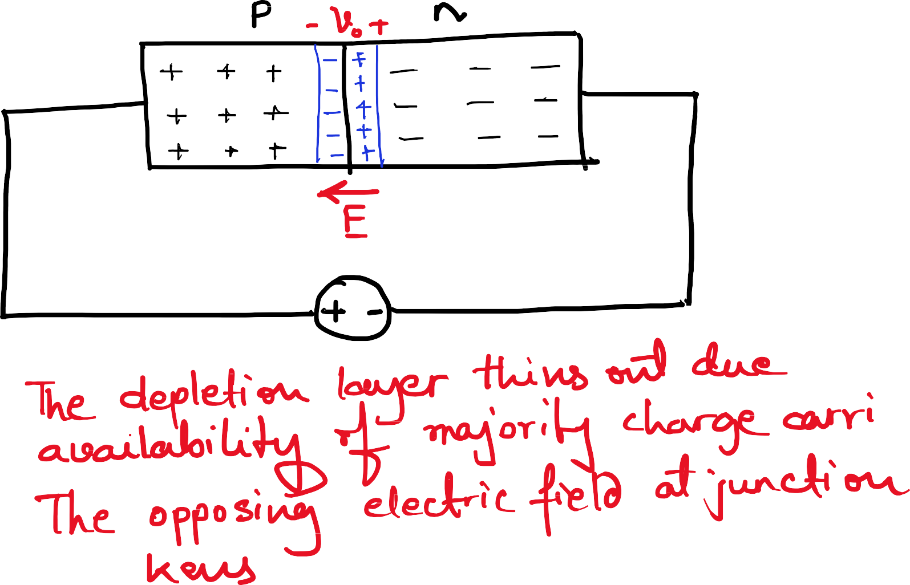



p-n Junction

Slide 17
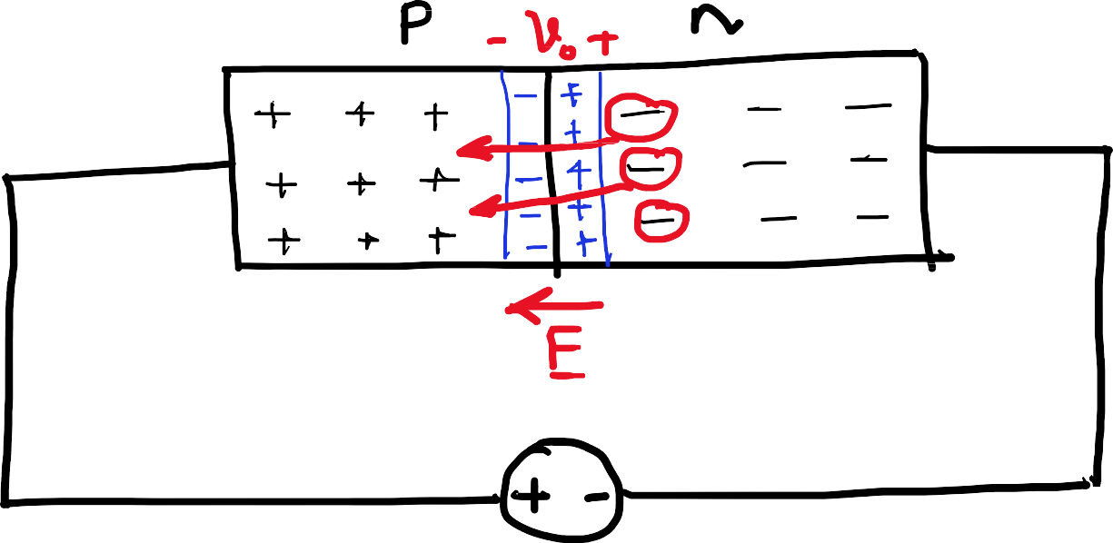

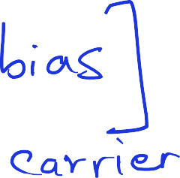


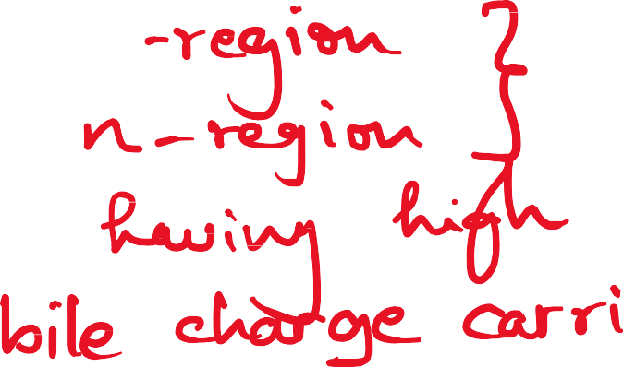


















p-n Junction

Slide 18
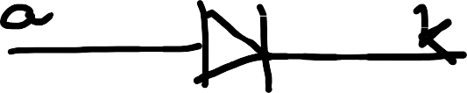
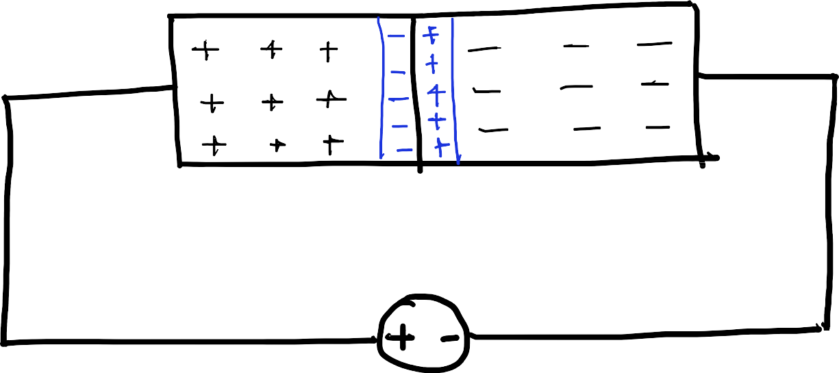
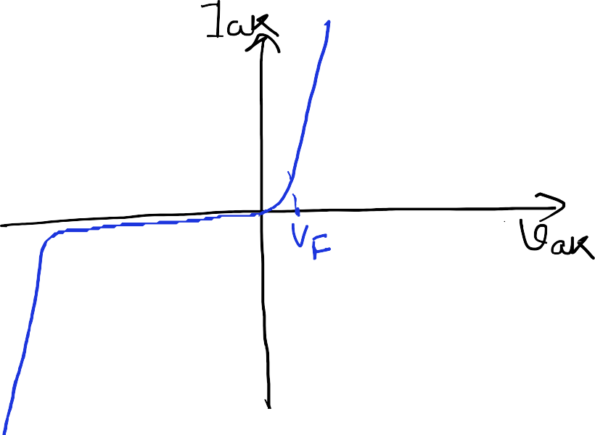















p-n Junction

Slide 19
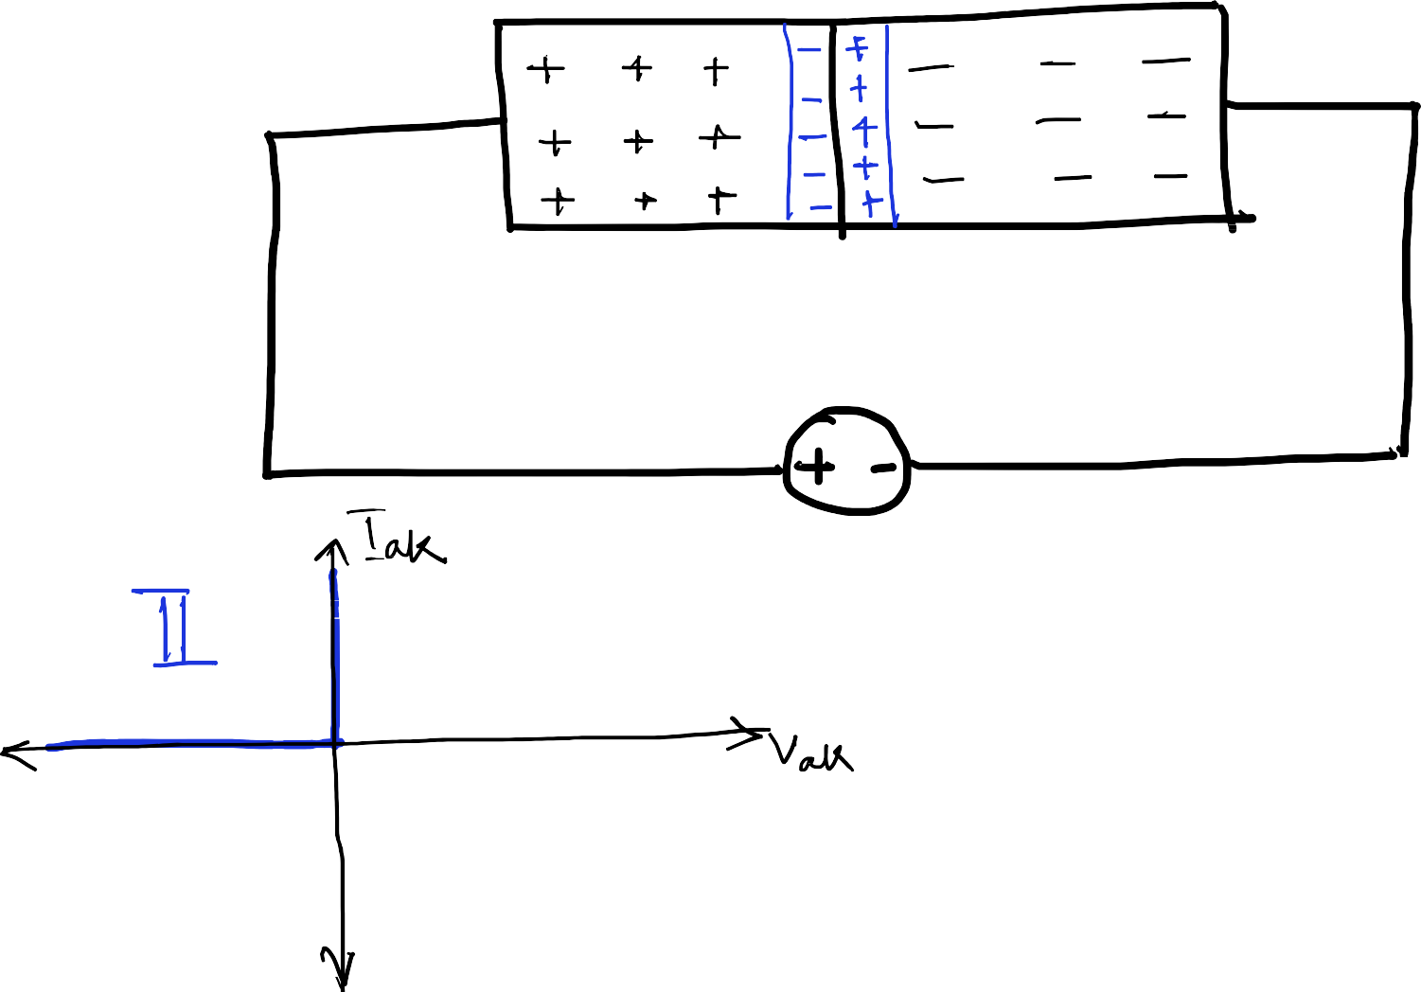

p-n Junction

Slide 20
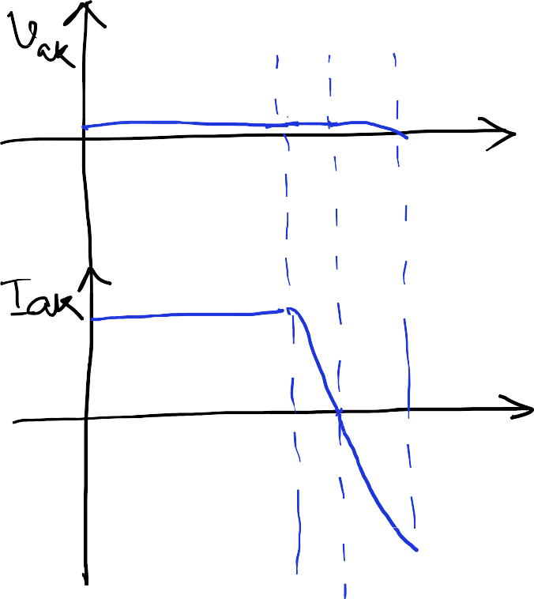
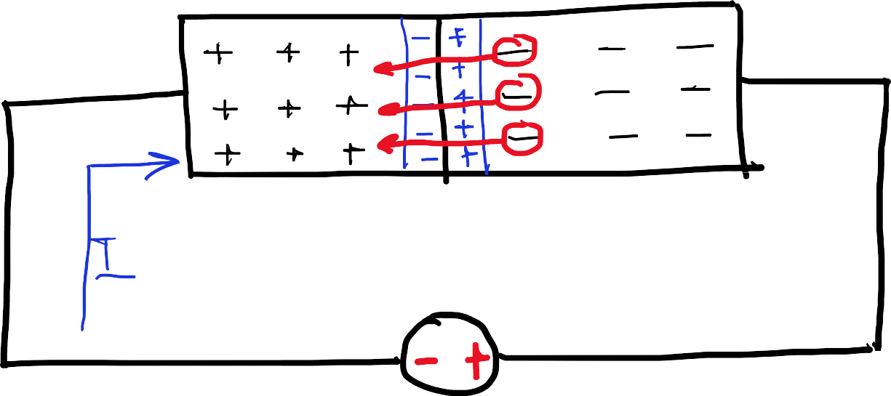
















Reverse recovery in diode

Slide 21
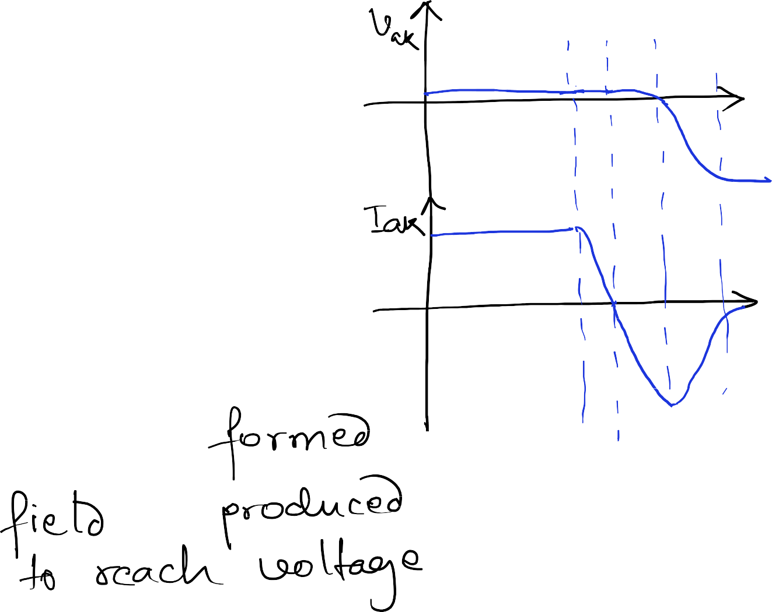

















Reverse recovery in diode

Slide 22
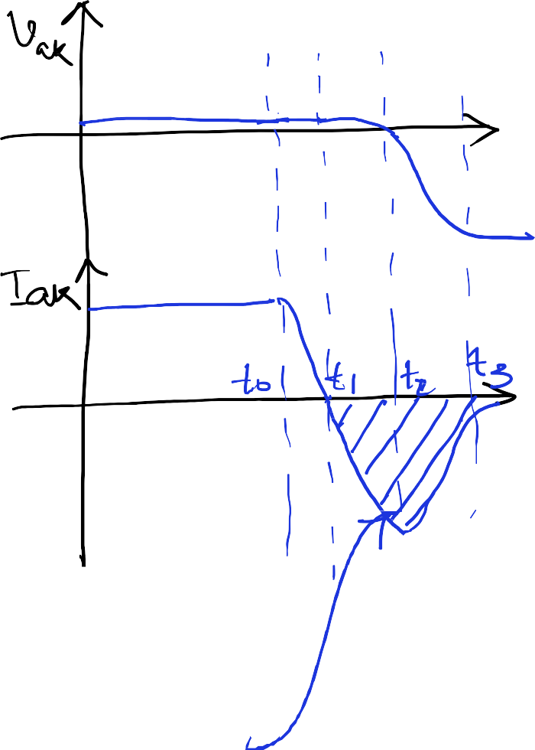


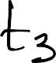



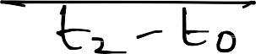
















Reverse recovery in diode

Slide 23
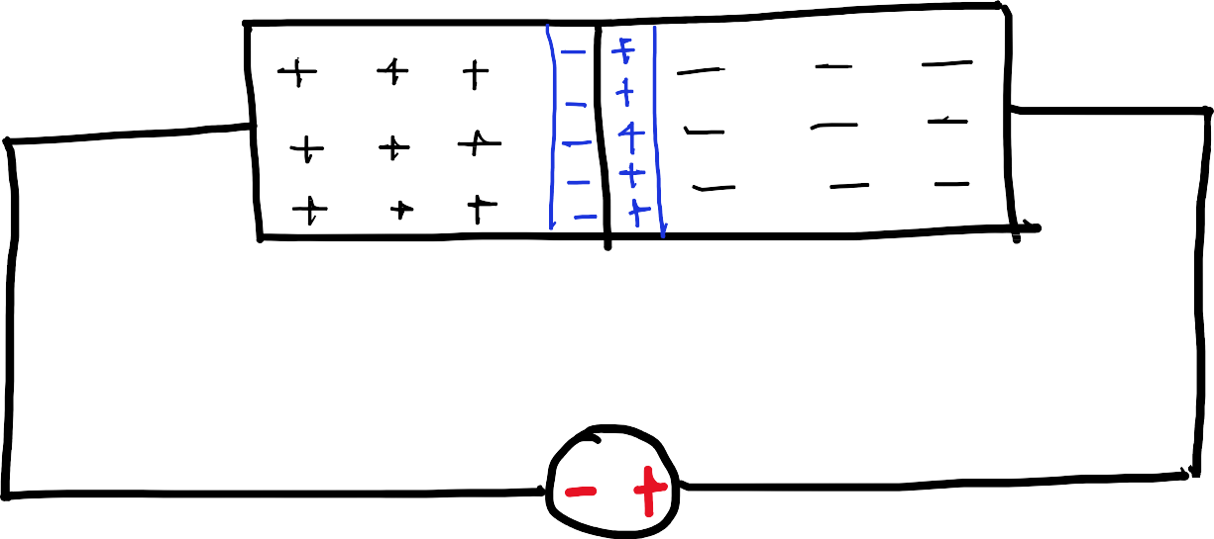












Power diode

Slide 24
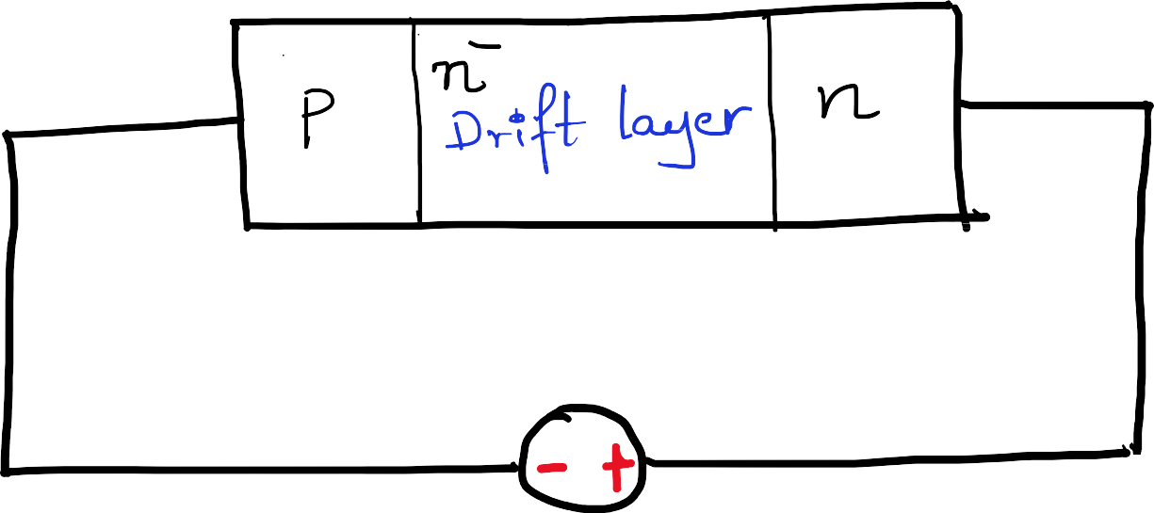




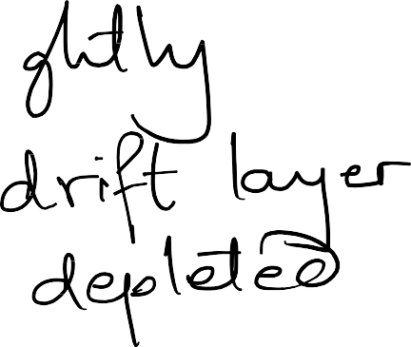





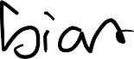

Power diode

Slide 25










Power diode

Slide 26





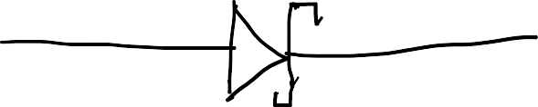





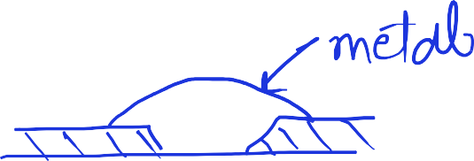






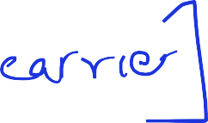
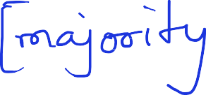
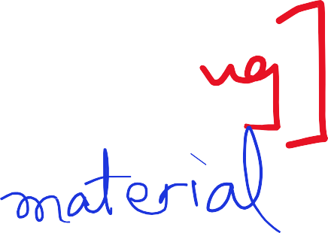



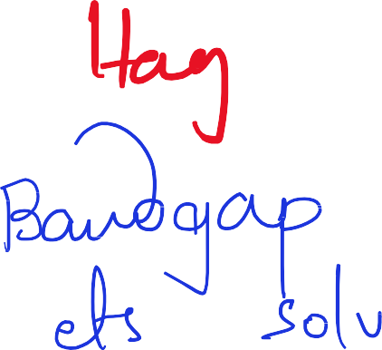














Power diode

Slide 27
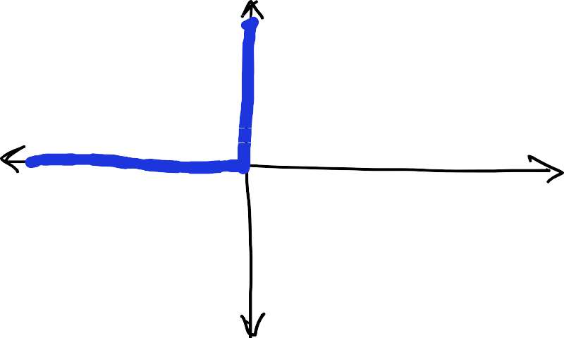












Power diode

Slide 28
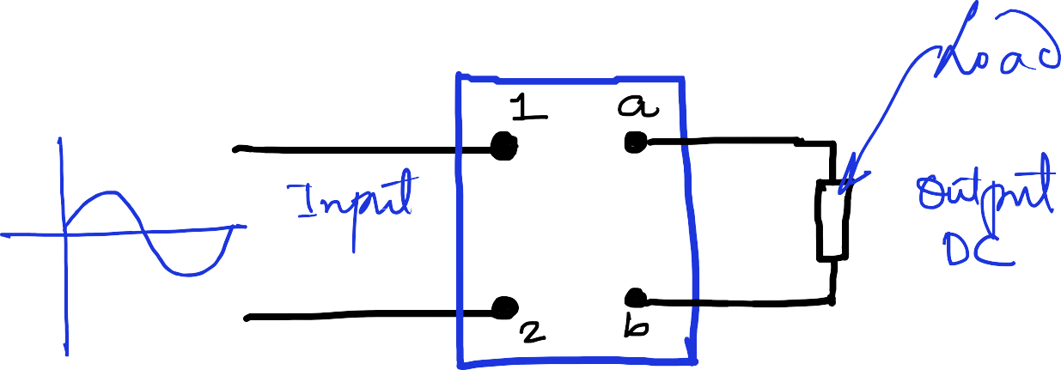
Rectifier
AC-DC Conversion

Slide 29
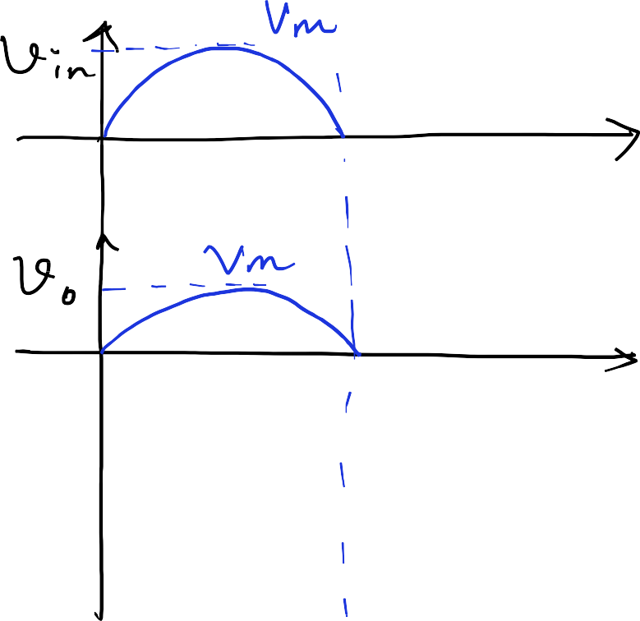
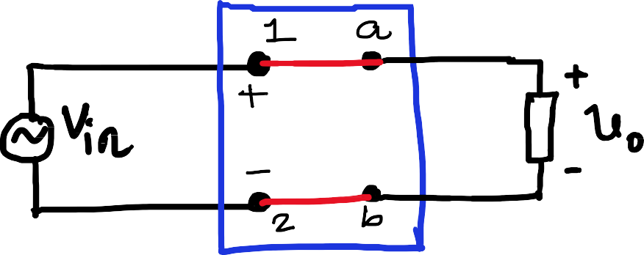


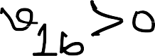

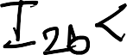
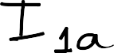

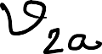

Rectifier
AC-DC Conversion

Slide 30
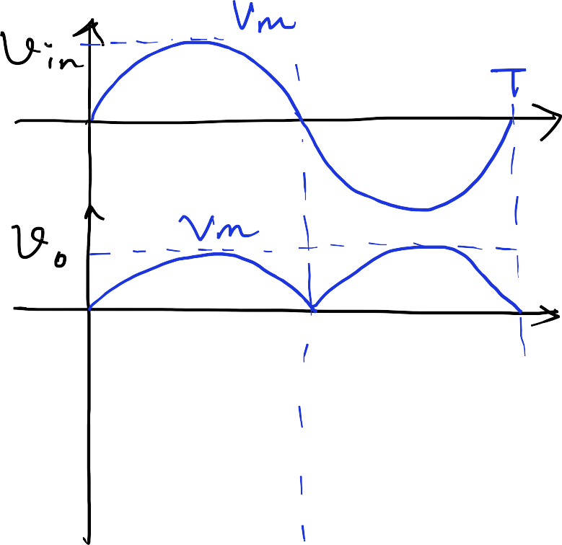
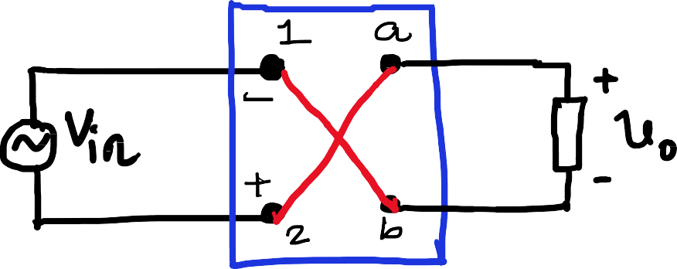


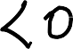
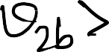
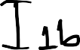


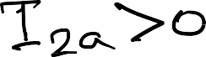
Rectifier
AC-DC Conversion

Slide 31
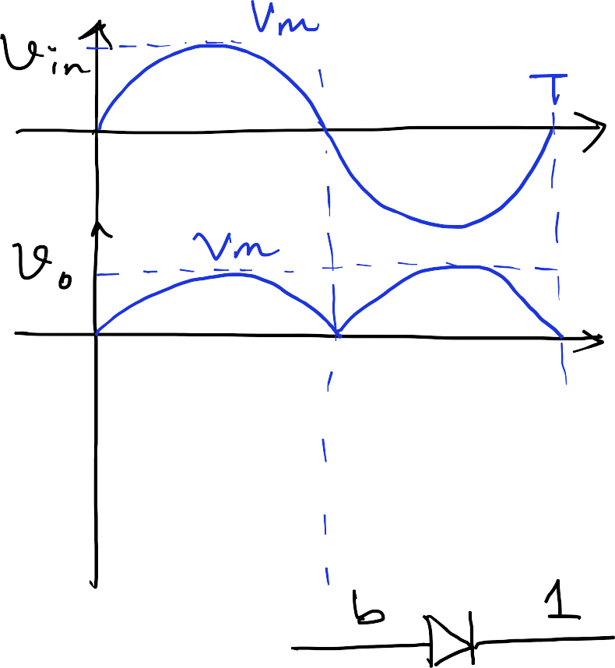
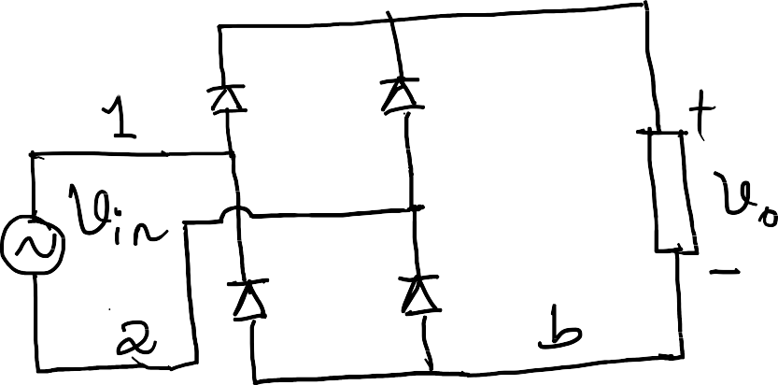






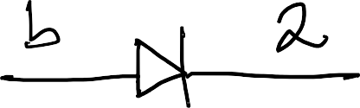
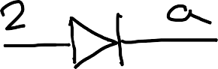
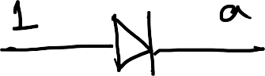
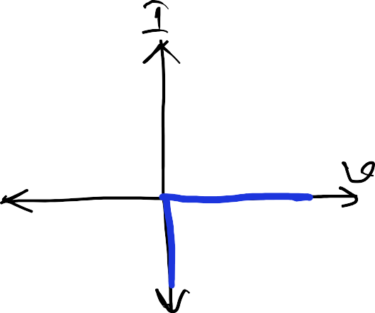
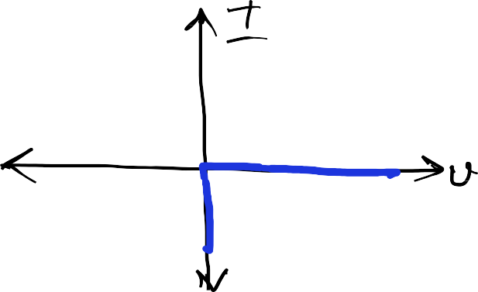

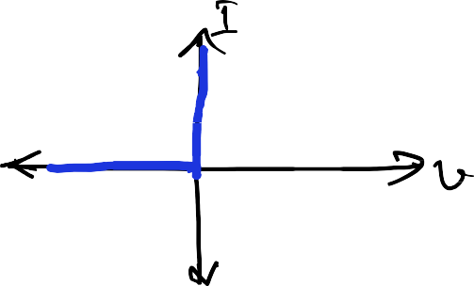
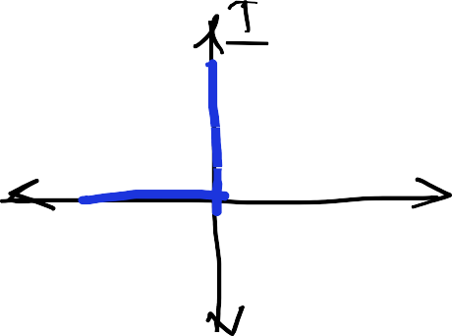




Rectifier
AC-DC Conversion

Slide 32
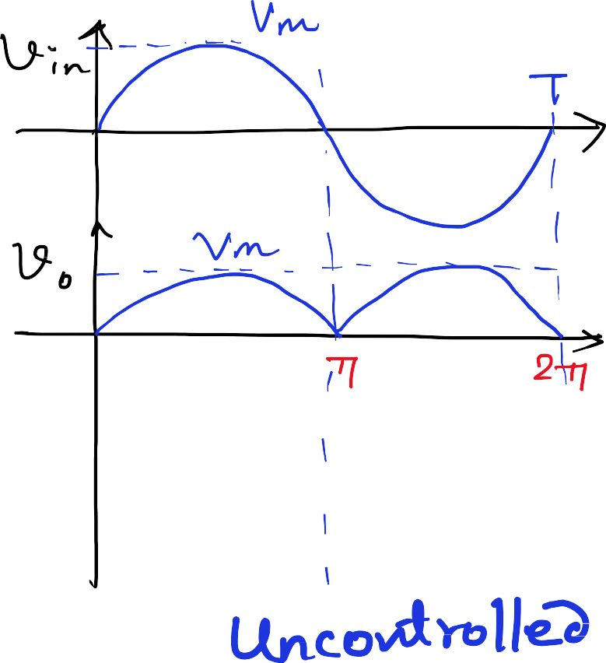
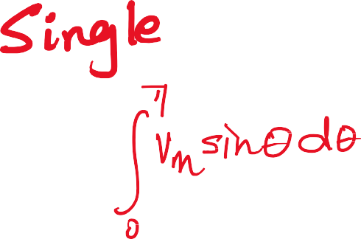














Rectifier
AC-DC Conversion

Slide 33





























Rectifier
AC-DC Conversion

Slide 34














Rectifier
AC-DC Conversion

Slide 35



















Rectifier
AC-DC Conversion

Slide 36














Rectifier
AC-DC Conversion

Slide 37








Rectifier
AC-DC Conversion

Slide 38









Rectifier
AC-DC Conversion

Slide 39
Power Electronics
ELL302
Semester I Academic Year 2022-23 Lecture 3
22nd August 2022

Slide 40
























Rectifier
AC-DC Conversion

Slide 41


















Rectifier
AC-DC Conversion

Slide 42















Rectifier
AC-DC Conversion

Slide 43











Rectifier
AC-DC Conversion

Slide 44


































Rectifier
AC-DC Conversion

Slide 45


Rectifier
AC-DC Conversion

Slide 46


















Single Phase Rectifier
Half Wave Rectifier

Slide 47



























Single Phase Rectifier
Full Wave Centre Tapped

Slide 48



















Three Phase Rectifier
Half wave rectifier

Slide 49








Three Phase Rectifier
Half wave rectifier

Slide 50


















Three Phase Rectifier
Half wave rectifier

Slide 51













Three Phase Rectifier
Full wave rectifier

Slide 52

































Rectifiers
Uncontrolled

Slide 53






































Controllable devices
Thyristor/Silicon Controlled Rectifier (SCR)

Slide 54



Controllable devices
Thyristor/Silicon Controlled Rectifier (SCR)

Slide 55
Power Electronics
ELL302
Semester I Academic Year 2022-23 Lecture 4
25th August 2022

Slide 56









Controlled Rectifier

Slide 57























Controlled Rectifier

Slide 58



















Controlled Rectifier
Fully controlled single phase full bridge

Slide 59




















Controlled Rectifier
Fully controlled single phase full bridge

Slide 60


















Controlled Rectifier
Fully controlled single phase full bridge

Slide 61














Controlled Rectifier
Fully controlled single phase full bridge

Slide 62

Controlled Rectifier
Fully controlled single phase full bridge

Slide 63








Controlled Rectifier
Fully controlled single phase full bridge

Slide 64



Controlled Rectifier
Fully controlled single phase full bridge

Slide 65







Controlled Rectifier
Fully controlled single phase full bridge

Slide 66





Controlled Rectifier
Fully controlled single phase full bridge

Slide 67








Controlled Rectifier
Fully controlled single phase full bridge

Slide 68








Controlled Rectifier
Semi controlled single phase full bridge

Slide 69


Controlled Rectifier
Semi controlled single phase full bridge

Slide 70




































Triggering Circuit

Slide 71














Controlled Rectifier
Three phase half wave

Slide 72




















Controlled Rectifier
Three phase half wave

Slide 73
















Controlled Rectifier
Three phase half wave

Slide 74











Controlled Rectifier
Three phase half wave

Slide 75








Controlled Rectifier
Three phase half wave

Slide 76
Power Electronics
ELL302
Semester I Academic Year 2022-23 Lecture 5
29th August 2022

Slide 77



Controlled Rectifier
Three phase half wave

Slide 78



Controlled Rectifier
Three phase full wave

Slide 79


Controlled Rectifier
Three phase full wave

Slide 80











Controlled Rectifier
Three phase full wave

Slide 81











Controlled Rectifier
Three phase full wave

Slide 82










Multiphase supply
Greater than 3

Slide 83



Multipulse rectifier
6pulse halfwave

Slide 84








Applications
HVDC Transmission
https://assets.siemens-energy.com/siemens/assets/api/uuid:8572c795-95c7-49e8-8367-dc578b4e59a5/2021-09-27-hvdc- classic.pdf?ste_sid=f3de81187c555c51cce22d84eb2f7cbc

Slide 85
Power Electronics
ELL302
Semester I Academic Year 2022-23 Lecture 6
5th September 2022

Slide 86



Multipulse rectifier
6pulse halfwave

Slide 87



















Multipulse rectifier
6pulse halfwave

Slide 88

Multipulse rectifier
6pulse halfwave

Slide 89






AC-DC Rectifiers

Slide 90








DC-AC Converter

Slide 91
DC-AC Converter

Slide 92
DC-AC Converter

Slide 93
DC-AC Converter
Single phase DC-AC inverter

Slide 94
DC-AC Converter
Single phase DC-AC inverter

Slide 95
DC-AC Converter
Single phase DC-AC inverter

Slide 96
DC-AC Converter
Single phase DC-AC inverter

Slide 97
DC-AC Converter
Single phase DC-AC inverter

Slide 98
DC-AC Converter
Single phase DC-AC inverter

Slide 99
Power Electronics
ELL302
Semester I Academic Year 2022-23 Lecture 7
₈th
September 2022

Slide 100
Fourier Analysis

Slide 101
Fourier Analysis

Slide 102
Fourier Analysis

Slide 103
Fourier Analysis

Slide 104
Fourier Analysis

Slide 105
Fourier Analysis

Slide 106
Fourier Analysis

Slide 107
Fourier Analysis

Slide 108
Fourier Analysis

Slide 109
Fourier Analysis

Slide 110
Fourier Analysis

Slide 111
Fourier Analysis

Slide 112
Fourier Analysis

Slide 113
Fourier Analysis

Slide 114
Fourier Analysis

Slide 115
Fourier Analysis

Slide 116
Fourier Analysis

Slide 117
Fourier Analysis

Slide 118
DC-AC Converter
Single phase DC-AC inverter

Slide 119
DC-AC Converter
Single phase DC-AC inverter

Slide 120
DC-AC Converter
Single phase DC-AC inverter

Slide 121
DC-AC Converter
Single phase DC-AC inverter

Slide 122
DC-AC Converter
Single phase DC-AC inverter

Slide 123
DC-AC Converter
Single phase DC-AC inverter + Low pass filter

Slide 124
DC-AC Converter
Single phase DC-AC inverter + Low pass filter

Slide 125
DC-AC Converter
Single phase DC-AC inverter + Low pass filter

Slide 126
Power Electronics
ELL302
Semester I Academic Year 2022-23 Lecture 8
₁₂th
September 2022

Slide 127
DC-AC Converter
Single phase DC-AC inverter – phase shifting

Slide 128
DC-AC Converter
Single phase DC-AC inverter - phase shifting

Slide 129
DC-AC Converter
Single phase DC-AC inverter - phase shifting

Slide 130
DC-AC Converter
Single phase DC-AC inverter - phase shifting

Slide 131
DC-AC Converter
Single phase DC-AC inverter – reducing harmonics actively

Slide 132
DC-AC Converter
Generating pulses

Slide 133
DC-AC Converter
Generating pulses

Slide 134
DC-AC Converter
Generating pulses

Slide 135
DC-AC Converter
Generating pulses

Slide 136
Power Electronics
ELL302
Semester I Academic Year 2022-23 Lecture 9
15th September 2022

Slide 137
Power MOSFET

Slide 138
Power MOSFET

Slide 139
Power MOSFET

Slide 140
Power MOSFET

Slide 141
Power MOSFET

Slide 142
Power MOSFET

Slide 143
Power MOSFET

Slide 144
Insulated gate bipolar transistors (IGBT)

Slide 145
Insulated gate bipolar transistors (IGBT)

Slide 146
DC-AC Inverter
3-phase

Slide 147
DC-AC Inverter
3-phase

Slide 148
DC-AC Inverter
3-phase

Slide 149
Power Electronics
ELL302
Semester I Academic Year 2022-23 Lecture 10
19th September 2022

Slide 150
DC-AC Inverter
3-phase

Slide 151
DC-AC Inverter
3-phase

Slide 152
DC-AC Inverter
3-phase

Slide 153
DC-AC Inverter
3-phase

Slide 154
DC-AC Inverter
3-phase

Slide 155
DC-AC Inverter
3-phase

Slide 156
DC-AC Inverter
3-phase

